Slide 1
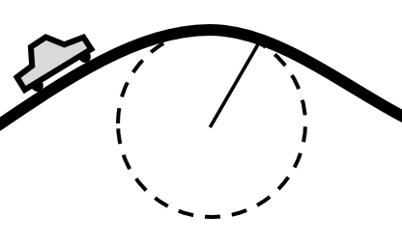
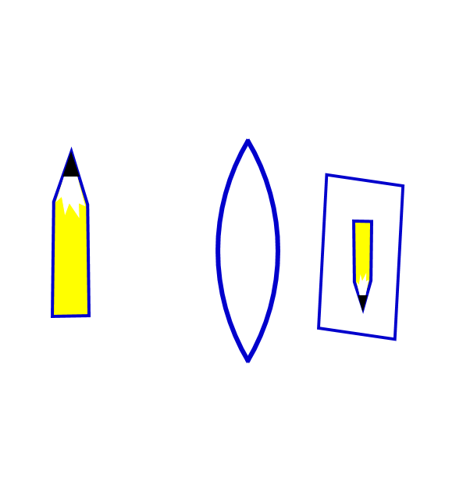
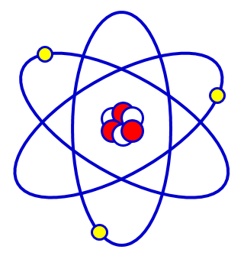
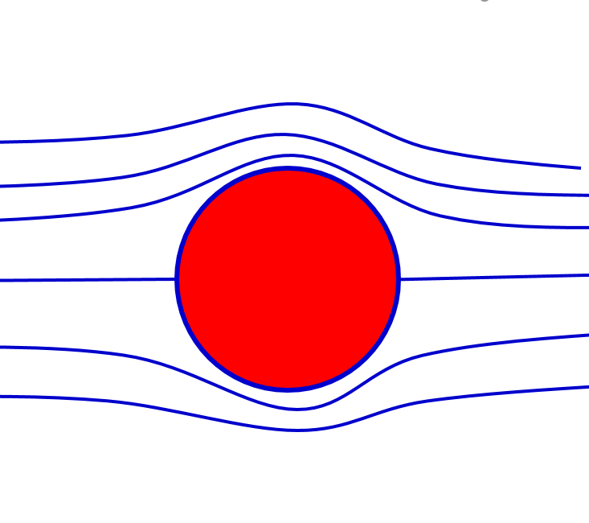
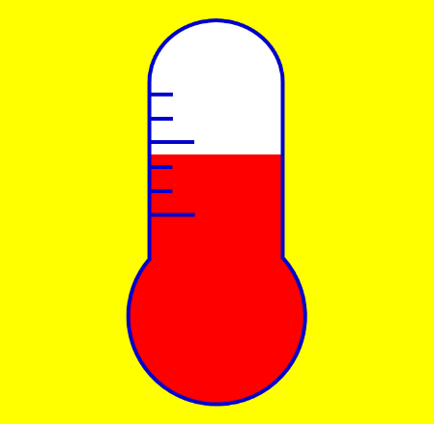
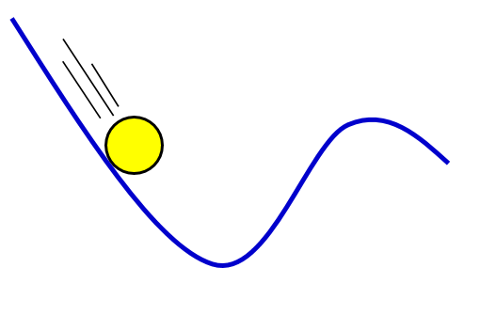
Physics & Astronomy at AHC
Rob Jorstad
STEM Week of Discovery
August 9, 2023

Slide 2
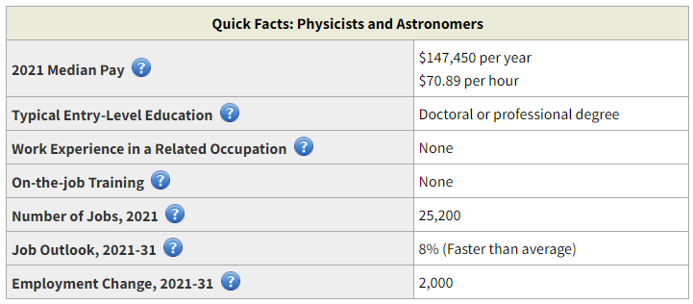
Physics
GOOD
Yikes!
GOOD
https://www.bls.gov/ooh/life-physical-and-social-science/physicists-and-astronomers.htm#tab-1

Slide 3
Physics
If you want jobs in academia or research
Courses in calculus, linear algebra, stats
Computer science typically useful
Get a Bachelor’s degree (4 years)
Get a Ph.D. (6 years, paid $25k + all school expenses)
Often require 1 or more post-docs (2-6 years, paid $65k)
That’s 12-16 years before getting paid $150k…
What can you do with a Bachelor’s degree?
Technician or assistant in related fields
Engineering
Computer science
Data Science
K-12 Teaching
Some government jobs
Average starting at $60k but ranges wildly
Out perform pre-meds on MCAT (source: APS, 2015)
Out perform pre-law on LSAT (source: APS, 2015)
https://www.bls.gov/ooh/life-physical-and-social-science/physicists-and-astronomers.htm#tab-4
https://www.aps.org/careers/guidance/webinars/upload/Careers-Talk.pdf, salary info from multiple source including Zip Recruiter, UC Merced, APS, etc

Slide 4
Physics
“Important Qualities” to be Successful in Physics & Astronomy
Analytical skills
Evaluate work (your own & other’s) to avoid errors
Communication skills
Present to the public and write technical reports
Critical-thinking skills
Determine if results & conclusions are accurate using logic
Interpersonal skills
Collaborate and work well with team members & colleagues
Math skills
Use calculus, algebra, geometry, & “other areas of math”
Problem-solving skills
Observe & analyze carefully. “For example, they may need to redesign their approach and find alternatives when an experiment of theory fails to produce the desired result.”
Self-discipline
Stay motivated & “focus on large data sets for long periods”
https://www.bls.gov/ooh/life-physical-and-social-science/physicists-and-astronomers.htm#tab-4

Slide 5
Quotes from Carnegie Mellon Students
Physics is an infamously difficult course. I consistently needed help with the material. It is not impossible though. | Physics is incredibly intimidating and difficult. I used office hours and tutoring and built a strong bridge and was successful in the class. | Weekly study groups were most effective of all the support offered because it forced me to form a study routine and it allowed me to work closely with other students in small groups.
Brian Electrical & Computer Engineering | Mridula Chemistry | Rohan Math
https://www.cmu.edu/student-success/other-resources/fast-facts/succeed-in-physics.pdf

Slide 6
Quotes from Carnegie Mellon Students
Physics is an infamously difficult course. I consistently needed help with the material. It is not impossible though. | Physics is incredibly intimidating and difficult. I used office hours and tutoring and built a strong bridge and was successful in the class. | Weekly study groups were most effective of all the support offered because it forced me to form a study routine and it allowed me to work closely with other students in small groups.
Brian Electrical & Computer Engineering | Mridula Chemistry | Rohan Math
https://www.cmu.edu/student-success/other-resources/fast-facts/succeed-in-physics.pdf

Slide 7
Quotes from Carnegie Mellon Students
Physics is an infamously difficult course. I consistently needed help with the material. It is not impossible though. | Physics is incredibly intimidating and difficult. I used office hours and tutoring and built a strong bridge and was successful in the class. | Weekly study groups were most effective of all the support offered because it forced me to form a study routine and it allowed me to work closely with other students in small groups.
Brian Electrical & Computer Engineering | Mridula Chemistry | Rohan Math
https://www.cmu.edu/student-success/other-resources/fast-facts/succeed-in-physics.pdf

Slide 8
Quotes from Carnegie Mellon Students
Physics is an infamously difficult course. I consistently needed help with the material. It is not impossible though. | Physics is incredibly intimidating and difficult. I used office hours and tutoring and built a strong bridge and was successful in the class. | Weekly study groups were most effective of all the support offered because it forced me to form a study routine and it allowed me to work closely with other students in small groups.
Brian Electrical & Computer Engineering | Mridula Chemistry | Rohan Math
https://www.cmu.edu/student-success/other-resources/fast-facts/succeed-in-physics.pdf

Slide 9
I just want to pass!
Physics builds upon itself
Put in time doing problems when the material is easy
or you’ll be behind when it gets difficult.
Understand conceptually
Formulas will only help if you understand how/when/why to apply them. Then reach for the calculator…
BEFORE class
Read or watch lecture vids and have materials ready.
With some knowledge base, more will stick from lecture.
DURING class
Sit front & center for best viewing angles (and forced engagement).
Ask if something makes no sense (it happens daily).
AFTER class
Review your notes to see if you actually understand/remember.
Practice until you puke…and then practice some more.
Talk about things with others (other students, tutors, instructor)
From Carnegie Mellon https://www.cmu.edu/student-success/other-resources/fast-facts/succeed-in-physics.pdf

Slide 10
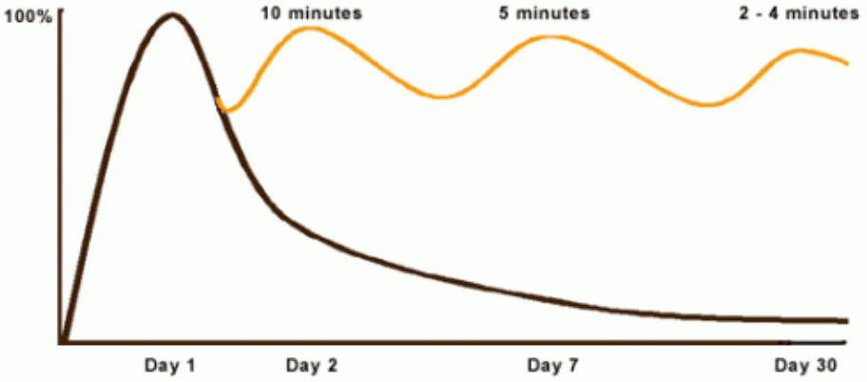
The Curve of Forgetting
% of Knowledge retained
Time req’d to get back to 100% understanding
Days after learning material in lecture
10
From U Waterloo https://uwaterloo.ca/campus-wellness/curve-forgetting

Slide 11
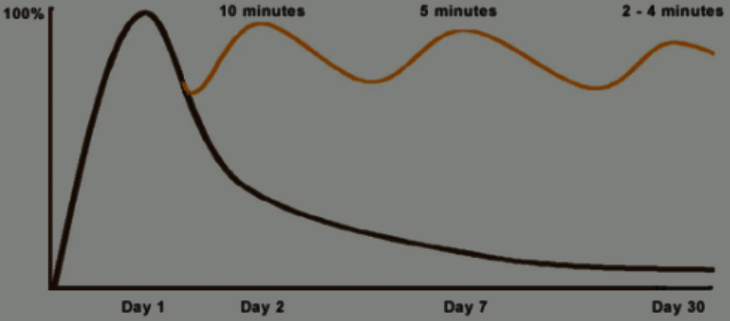
The Curve of Forgetting
Why have a study group?
You forget if you don’t practice.
It is more fun & efficient to practice with a group
When you explain to others, you understand more.
When you are forced to articulate a question, you learn more.
11
From U Waterloo https://uwaterloo.ca/campus-wellness/curve-forgetting

Slide 12
Main
Takeaways
Come in prepared on day 1
Come early on 1st lab day
Read book & watch lectures
Start homework early
Avoid excessive reliance on solutions
Get a good 2-6 person study group (no flakes)
Go to office hours
Time management: Plan your study schedule for all classes
Most physics jobs require a 12+ years

Slide 13
Come in prepared on day 1
Come early on 1st lab day
Read book & watch lectures
Start homework early
Avoid excessive reliance on solutions
Get a good 2-6 person study group (no flakes)
Go to office hours
Time management: Plan your study schedule for all classes
Main
Takeaways

