Slide 1
Characterizing the motion of a zombie during an attack title should be meaningful but as concise as possible
Queen Zebra X & A. Large Fish
2/22/22

Slide 2
Characterizing the motion of a zombie during an attack title should be meaningful but as concise as possible
Queen Zebra X & A. Large Fish
2/22/22

Slide 3
Characterizing the motion of a zombie during an attack title should be meaningful but as concise as possible
Queen Zebra X & A. Large Fish
2/22/22
(use the date of the presentation)

Slide 4
Characterizing the motion of a zombie during an attack title should be meaningful but as concise as possible
Queen Zebra X & A. Large Fish
2/22/22
(use the date of the presentation)
gee…a photo would look nice here…
if you use an internet image, always cite your source
I usually accept a web link on the same page as the image in 14 point font
everything else should be 18 pnt font or larger

Slide 5
Fonts for text:
Calibri
Corbel
Candara
Consolas
Constantia
Cambria
Fonts for code:
Courier New
Lucida Sans Typewriter
Fonts for text:
Calibri
Corbel
Candara
Consolas
Constantia
Cambria
Fonts for code:
Courier New
Lucida Sans Typewriter
Fonts for text:
Calibri
Corbel
Candara
Consolas
Constantia
Cambria
Fonts for code:
Courier New
Lucida Sans Typewriter
Fonts for text:
Calibri
Corbel
Candara
Consolas
Constantia
Cambria
Fonts for code:
Courier New
Lucida Sans Typewriter

Slide 6
Fonts for text:
Calibri
Corbel
Candara
Consolas
Constantia
Cambria
Fonts for code:
Courier New
Lucida Sans Typewriter
Fonts for text:
Calibri
Corbel
Candara
Consolas
Constantia
Cambria
Fonts for code:
Courier New
Lucida Sans Typewriter
Fonts for text:
Calibri
Corbel
Candara
Consolas
Constantia
Cambria
Fonts for code:
Courier New
Lucida Sans Typewriter
Fonts for text:
Calibri
Corbel
Candara
Consolas
Constantia
Cambria
Fonts for code:
Courier New
Lucida Sans Typewriter

Slide 7
Expectations for Figures & Equations
You should be using this opportunity to learn the following:
how to use the equation editor
how to make your own figures
how to make plots

Slide 8
Expectations for Figures & Equations
You should be using this opportunity to learn the following:
how to use the equation editor
how to make your own figures
how to make plots
Learning the tools is more professional and eventually faster.

Slide 9
Expectations for Figures & Equations
You should be using this opportunity to learn the following:
how to use the equation editor
how to make your own figures
how to make plots
Learning the tools is more professional and eventually faster.
Training vids in this playlist:
https://www.youtube.com/playlist?list=PL4Sl1ZPMcTDVt4a2PadxWx9d3EWoBZV3n
If you don’t watch them and produce shoddy work, expect low scores.

Slide 10
Expectations for Figures & Equations
Notice I added slide numbers.
1) “Insert” tab
2) Slide Number
Upped font size using
1) “View” tab
2) Slide Master
3) Upped font size
for each type of slide
You should be using this opportunity to learn the following:
how to use the equation editor
how to make your own figures
how to make plots
Learning the tools is more professional and eventually faster.
Training vids in this playlist:
https://www.youtube.com/playlist?list=PL4Sl1ZPMcTDVt4a2PadxWx9d3EWoBZV3n
If you don’t watch them and produce shoddy work, expect low scores.

Slide 11
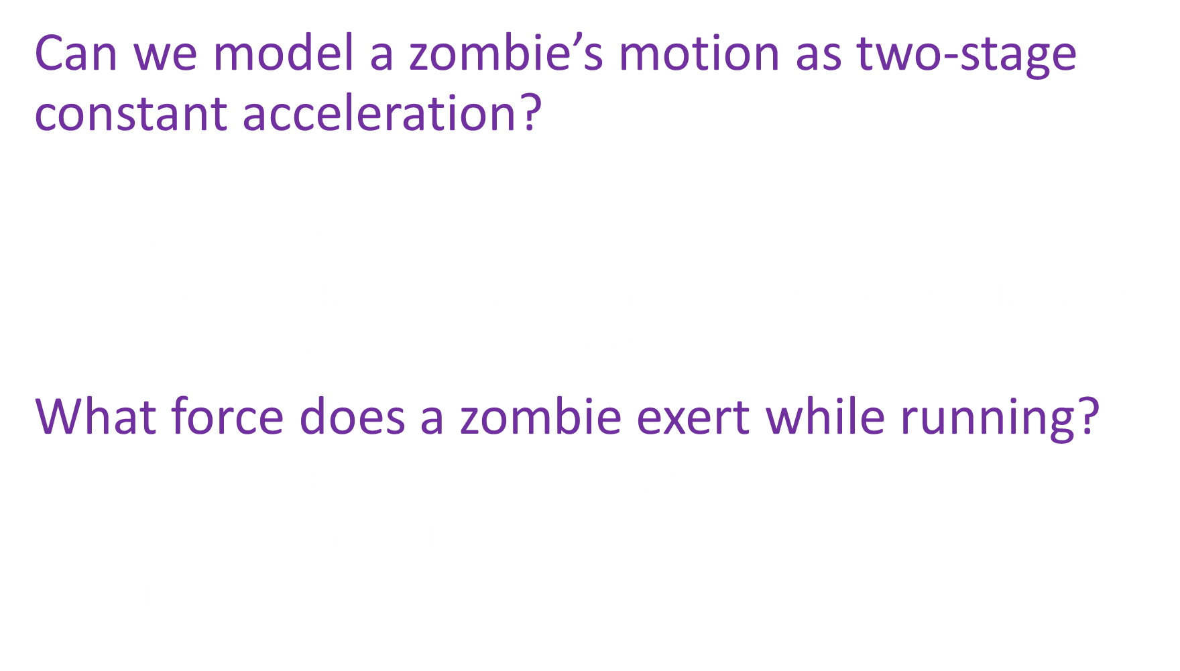
Question
Can we model a zombie’s motion as two-stage constant acceleration?
Yes
$a_{1}=8.9±0.8\frac{m}{s^{2}}$ or $a_{1}=8.9\frac{m}{s^{2}}±9\%$
Note: if you have a theory value, include both exp & th with a % diff given by $\%diff=\frac{exp−th}{th}×100\%$
What force does a zombie exert while running?
$F≈940±80 N$ or $F≈935 N±9\%$
Average horizontal force
Ignores resistive forces

Slide 12
Question
Can we model a zombie’s motion as two-stage constant acceleration?
Yes
$a_{1}=8.9±0.8\frac{m}{s^{2}}$ or $a_{1}=8.9\frac{m}{s^{2}}±9\%$
Note: if you have a theory value, include both exp & th with a % diff given by $\%diff=\frac{exp−th}{th}×100\%$
What force does a zombie exert while running?
$F≈940±80 N$ or $F≈935 N±9\%$
Average horizontal force
Ignores resistive forces
A photo or figure helps explain the questions asked.
Tip: always include a ruler or scale bar to help the audience understand.

Slide 13
Procedure
Relevant images here
If not your own,
cite in 14 pnt font!
Show a picture instead of this bulleted list
Perhaps show a video as well
  Make sure the video will work
  Have at least two different ways to show the vid
    On flash drive
    On cloud
    Embedded in slide show (I rarely trust this)
    On youtube
The idea here is to explain what is going on
in the pictures/videos without subjecting
people to a boring, bulleted list of supplies…

Slide 14
Procedure
Relevant images here
If not your own,
cite in 14 pnt font!
Show a picture instead of this bulleted list
Perhaps show a video as well
  Make sure the video will work
  Have at least two different ways to show the vid
    On flash drive
    On cloud
    Embedded in slide show (I rarely trust this)
    On youtube
The idea here is to explain what is going on
in the pictures/videos without subjecting
people to a boring, bulleted list of supplies…

Slide 15
Theory
Relevant images here
Note: a simple block diagram is often useful here. A block diagram next to a photo is powerful. The photo shows the real life image while the simplified diagram shows the parts of the real life image that are actually used in the physical model we care about.
The idea is to have your block diagram show a simplified model of your complicated looking apparatus pictures.
Note: you are expected to learn how to make your own diagrams. Here is a training vid:
https://www.youtube.com/watch?v=1WeU8IuCNuQ&list=PL4Sl1ZPMcTDVt4a2PadxWx9d3EWoBZV3n&index=7

Slide 16

Theory
Your block diagram should use identical variables to those mentioned in the theory.
You could have them animate in at the same time…
They could also be color coded.
When color-coding, use colors with high contrast. Avoid things like yellow on white or dark blue on black.
When speaking, refer to things by color but also by name (in case any students are color blind).
Training vid on how to use the equation editor: https://www.youtube.com/watch?v=DR_Dp9i65Y8&list=PL4Sl1ZPMcTDVt4a2PadxWx9d3EWoBZV3n&index=6
If constant acceleration
$x\left(t\right)=x_{i}+v_{i}t+\frac{1}{2}at^{2}$
$v\left(t\right)=v_{i}+at$

Slide 17
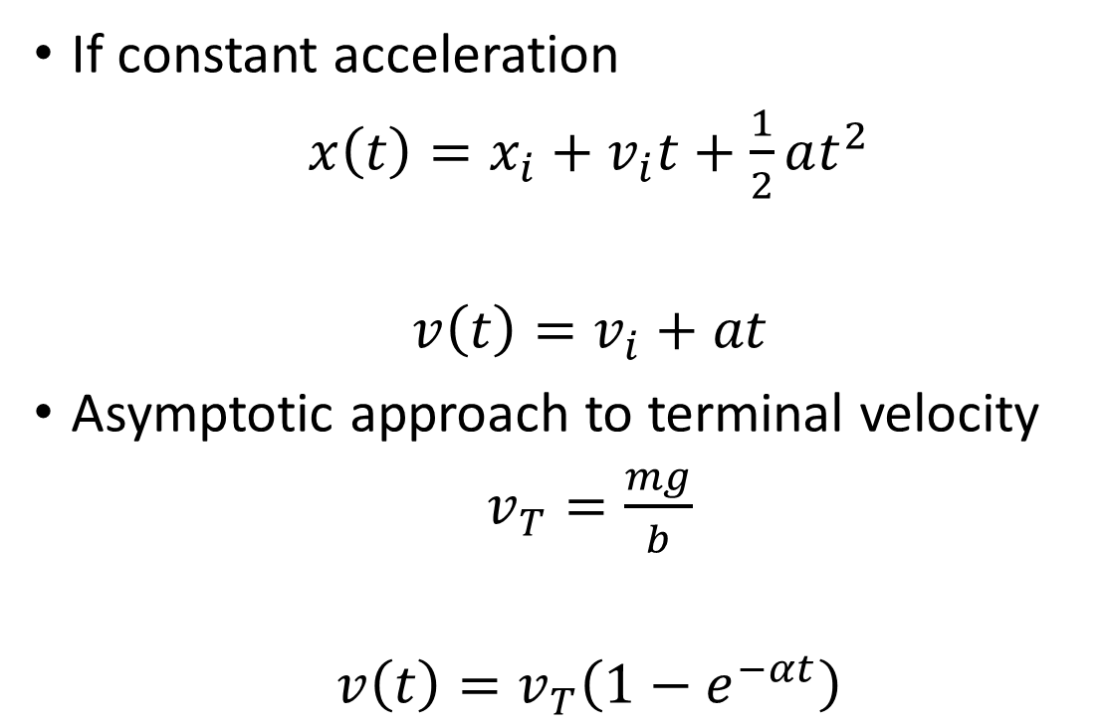
Theory
Relevant images here
If constant acceleration
$x\left(t\right)=x_{i}+v_{i}t+\frac{1}{2}at^{2}$
$v\left(t\right)=v_{i}+at$
Asymptotic approach to terminal velocity
$v_{T}=\frac{mg}{b}$
$v\left(t\right)=v_{T}\left(1−e^{−αt}\right)$

Slide 18
Other theory ideas might be…
You could explain the equations used for a pendulum (explain what amplitude period, omega, and phase angle are)
  Include a figure so people can see things as well as read the definitions
You could explain how forces relate
  Include super simple figure of ball bouncing (or what have you)
  Include an FBD
  Include force equations

Slide 19

Theory (cont.)
If you have force equations, better have a well labeled FBD.
Tip: use the equation editor on all labels in the FBD to ensure visual consistency between the diagram and the equations.
If constant acceleration
$ΣF_{x}=ma_{x}$
$F−R=ma$

Slide 20

Theory (cont.)
If you have force equations, better have a well labeled FBD.
Tip: use the equation editor on all labels in the FBD to ensure visual consistency between the diagram and the equations.
If constant acceleration
$ΣF_{x}=ma_{x}$
$F−R=ma$
Ignoring resistive forces ($R≈0$)
$F=ma$

Slide 21
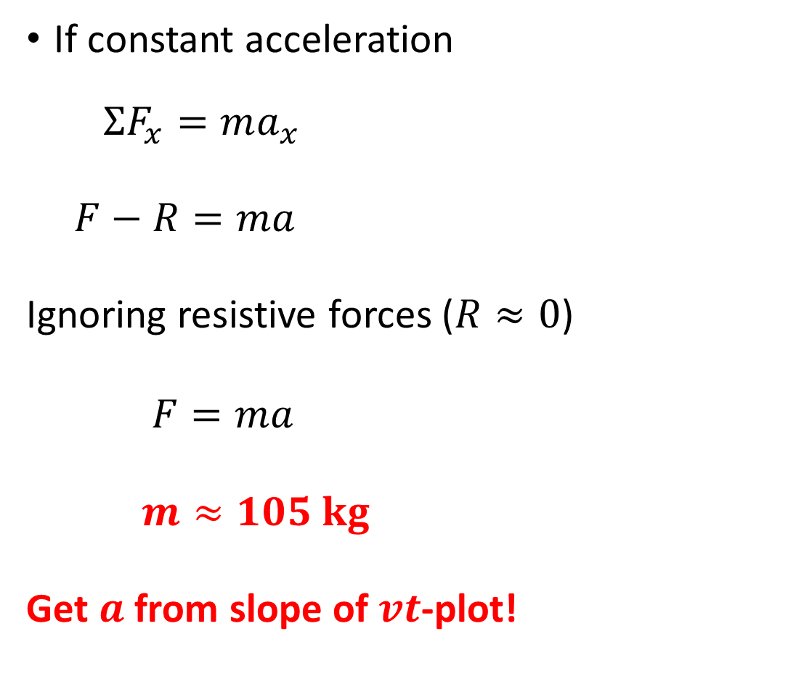
Theory (cont.)
If you have force equations, better have a well labeled FBD.
Tip: use the equation editor on all labels in the FBD to ensure visual consistency between the diagram and the equations.
If constant acceleration
$ΣF_{x}=ma_{x}$
$F−R=ma$
Ignoring resistive forces ($R≈0$)
$F=ma$
$m≈105 kg$
Get $a$ from slope of $vt$-plot!

Slide 22
Question
Can we model a zombie’s motion as two-stage constant acceleration?
Yes
$a_{1}=8.9±0.8\frac{m}{s^{2}}$ or $a_{1}=8.9\frac{m}{s^{2}}±9\%$
Note: if you have a theory value, include both exp & th with a % diff given by $\%diff=\frac{exp−th}{th}×100\%$
What force does a zombie exert while running?
$F≈940±80 N$ or $F≈935 N±9\%$
Average horizontal force
Ignores resistive forces
if you feel it is right, consider revisiting the goal slide to keep everyone on track

Slide 23
Check font size first (>18 point)
Changing font size/color erases other formatting
Increments on each axis should end in 1, 2, or 5 Exception: angular increments in degrees must hit 𝟗𝟎°
Include axis labels at the end of the positive axis
Units are NOT italicized, Variables ARE italicized
Can use words (not italicized) instead of variable names Tick marks on each axis
Stretch plot to fit the almost the entire slide?
Color coding consistent throughout talk?
Space between label and units!
When major increment is multiple of 2, must modify default minor increment to 1, 2, or 5!

Slide 24

$$v_{1}=slope$$
$$v_{1}≈\frac{rise}{run}$$
$$v_{1}≈\frac{\left(0.29 \text{cm}\right)−(0.10 \text{cm})}{\left(0.20 \text{s}\right)−(0.10 \text{s})}$$
$$v_{1}≈1.9\frac{cm}{s}$$

Slide 25



$$v_{3}≈4.4\frac{cm}{s}$$
$$v_{2}=3.9\frac{cm}{s}$$
$$v_{1}=1.9\frac{cm}{s}$$

Slide 26
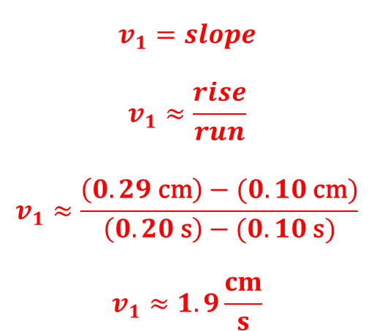



WATCH OUT! When adding equations to the graph, follow this procedure:
Paste the plot from Excel onto the slide but don’t make it full size yet.
Add a text box to some random spot on the slide NOT on top of the graph.
Use the equation editor to make your equation in the text box.
Now make the plot full size on the slide and move the equation into place.
This avoids a weird file save issue…
$$v_{1}=1.9\frac{cm}{s}$$
$$v_{2}=3.9\frac{cm}{s}$$
$$v_{3}=4.4\frac{cm}{s}$$
$$v_{1}=slope$$
$$v_{1}≈\frac{rise}{run}$$
$$v_{1}≈\frac{\left(0.29 \text{cm}\right)−(0.10 \text{cm})}{\left(0.20 \text{s}\right)−(0.10 \text{s})}$$
$$v_{1}≈1.9\frac{cm}{s}$$

Slide 28


Space between number & unit!
$$v_{1}=1.9 cm/s$$
$$v_{1}≈1.9 cm/s$$

Slide 29




$$v_{3}=4.4 cm/s$$
$$v_{2}=3.9 cm/s$$
$$v_{1}=1.9 cm/s$$
$$v_{3}≈4.4 cm/s$$
$$v_{2}≈3.9 cm/s$$
$$v_{1}≈1.9 cm/s$$

Slide 31


$$a_{2}≈0$$
$$a_{1}=slope$$
$$a_{1}≈\frac{rise}{run}$$
$$a_{1}≈\frac{\left(4.32\frac{cm}{s}\right)−\left(0.40\frac{cm}{s}\right)}{\left(0.40 \text{s}\right)−\left(0.00 \text{s}\right)}$$
$$a_{1}≈9.8\frac{cm}{s^{2}}$$

Slide 32
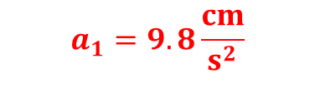
$$a_{2}≈0$$
$$a_{1}=9.8\frac{cm}{s^{2}}$$

Slide 33
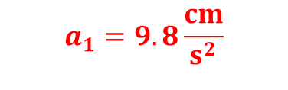
$$a_{1}=9.8\frac{cm}{s^{2}}$$
$$a_{2}≈0$$

Slide 35

$$v\left(t\right)=v_{T}\left(1−e^{−αt}\right)$$

Slide 36
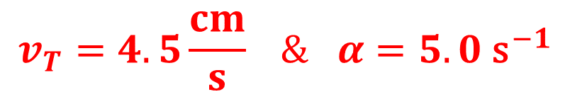
$$v\left(t\right)=v_{T}\left(1−e^{−αt}\right)$$
$$v_{T}=4.5\frac{cm}{s} \& α=5.0 {\text{s}}^{−1}$$

Slide 38
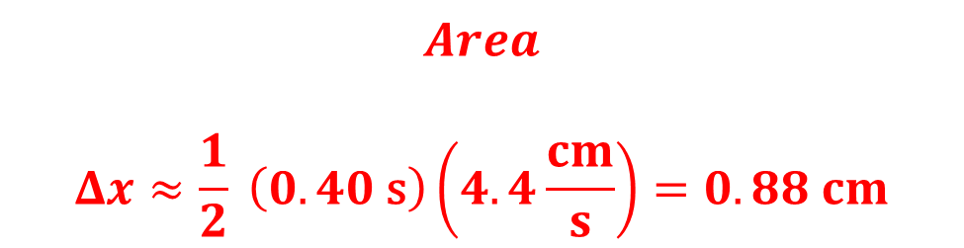
$$Area$$
$$Δx≈\frac{1}{2} \left(0.40 \text{s}\right)\left(4.4\frac{cm}{s}\right)=0.88 cm$$

Slide 40
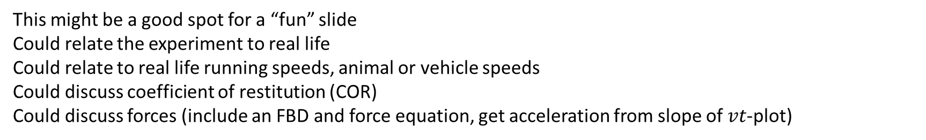
This might be a good spot for a “fun” slide
Could relate the experiment to real life
Could relate to real life running speeds, animal or vehicle speeds
Could discuss coefficient of restitution (COR)
Could discuss forces (include an FBD and force equation, get acceleration from slope of $vt$-plot)

Slide 41
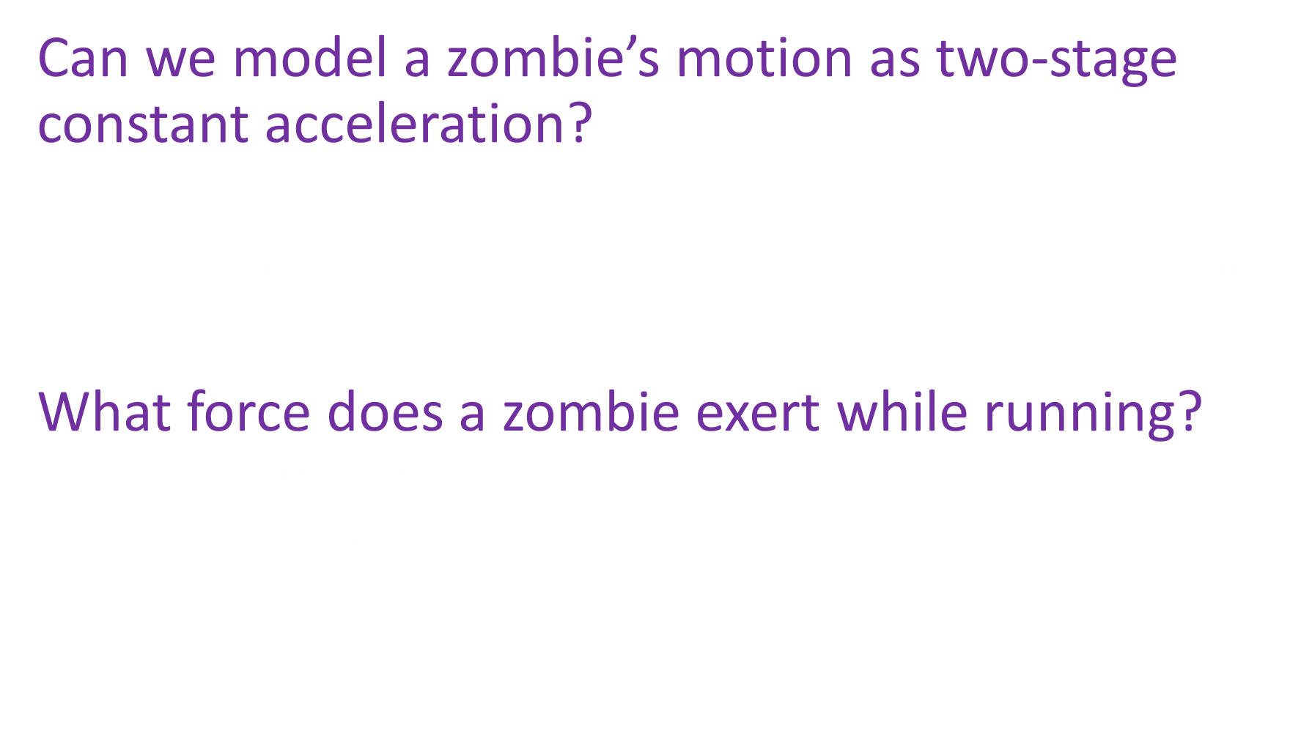
Question
Can we model a zombie’s motion as two-stage constant acceleration?
$a_{1}=8.9±0.8\frac{m}{s^{2}}$ or $a_{1}=8.9\frac{m}{s^{2}}±9\%$
Note: if you have a theory value, include both exp & th with a % diff
$\%diff=\frac{exp−th}{th}×100\%$
What force does a zombie exert while running?
$F≈940±80 N$ or $F≈935 N±9\%$
Average horizontal force
Ignores resistive forces

Slide 42
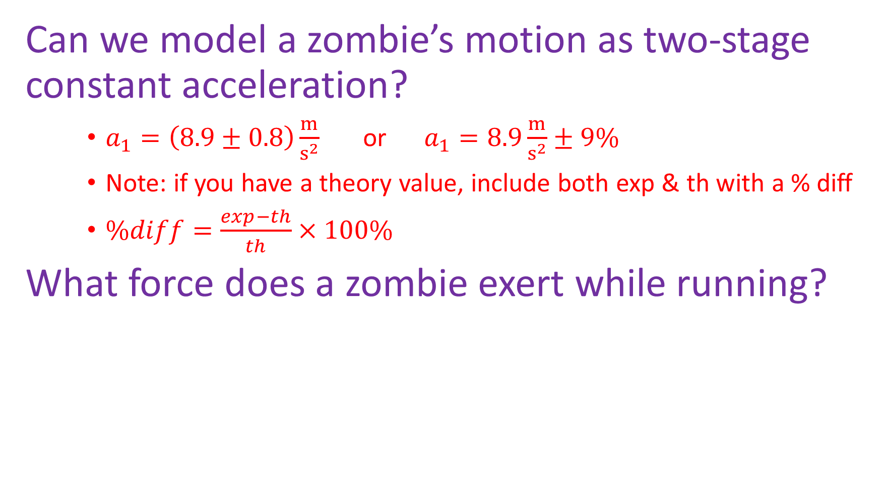
Question
Can we model a zombie’s motion as two-stage constant acceleration?
$a_{1}=\left(8.9±0.8\right)\frac{m}{s^{2}}$ or $a_{1}=8.9\frac{m}{s^{2}}±9\%$
Note: if you have a theory value, include both exp & th with a % diff
$\%diff=\frac{exp−th}{th}×100\%$
What force does a zombie exert while running?
$F≈940±80 N$ or $F≈935 N±9\%$
Average horizontal force
Ignores resistive forces

Slide 43
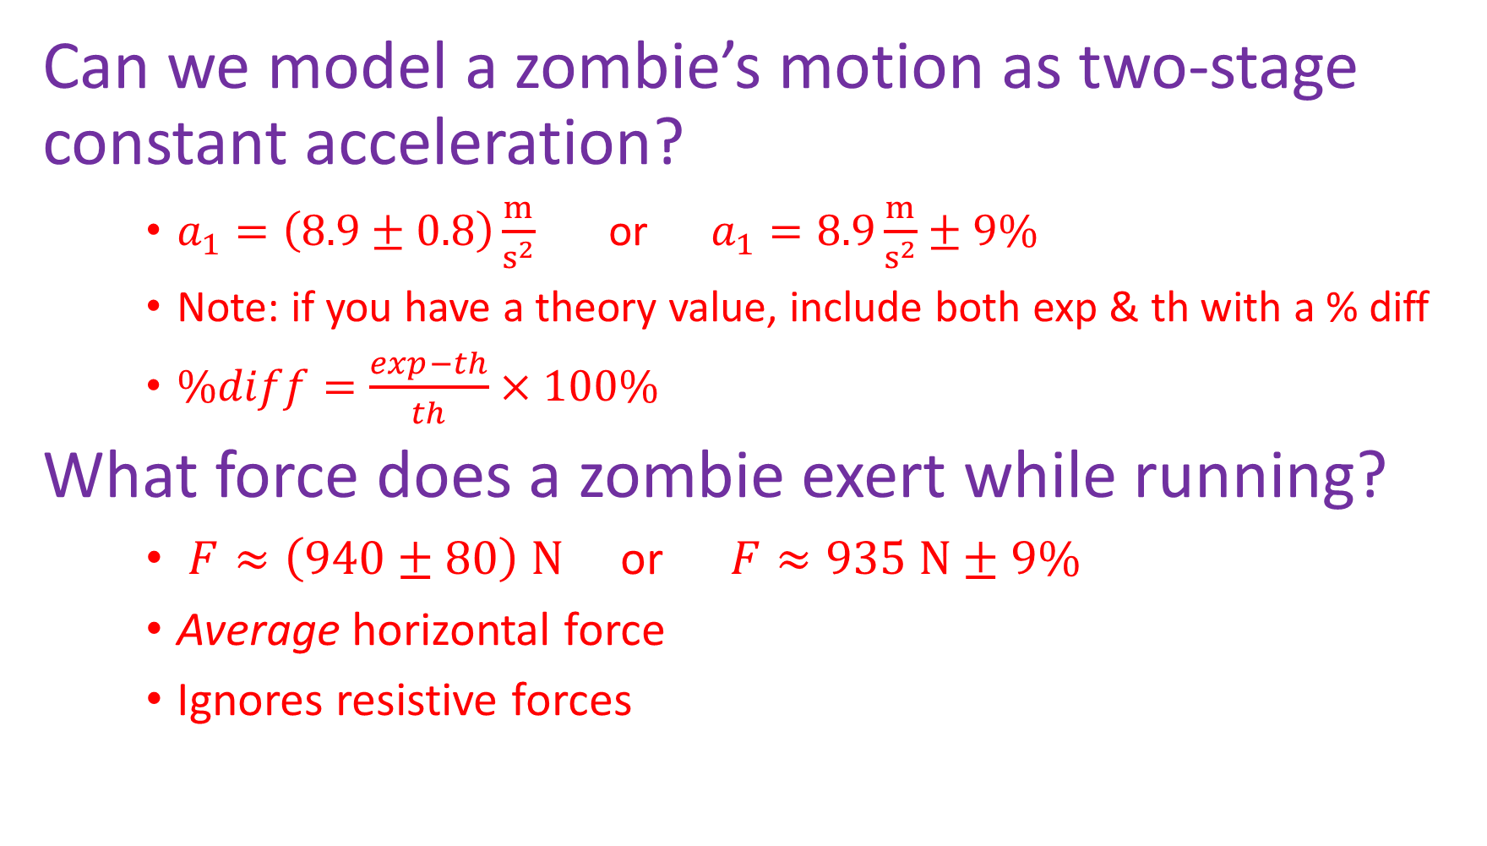
Question
Can we model a zombie’s motion as two-stage constant acceleration?
$a_{1}=\left(8.9±0.8\right)\frac{m}{s^{2}}$ or $a_{1}=8.9\frac{m}{s^{2}}±9\%$
Note: if you have a theory value, include both exp & th with a % diff
$\%diff=\frac{exp−th}{th}×100\%$
What force does a zombie exert while running?
$F≈\left(940±80\right) N$ or $F≈935 N±9\%$
Average horizontal force
Ignores resistive forces

Slide 44
Check over your presentation
Once the rough draft of your presentation is put together, read the manual again to see if you missed anything. This might help you find some things to talk about if you are worried your talk is too short.
Grade yourself using the rubric
http://www.robjorstad.com/Phys161/161Lab/161-1stPresGradingForm.pdf
Skim the student feedback form and self-critique your talk
http://www.robjorstad.com/OralPresStudentFeedbackForm.pdf

Slide 45
Practice
Ensure each person gets approximately equal speaking time (or lose points).
You will probably use a ruler as a pointer. Think about what you will be saying and where you should be pointing at the images/plots in your slides. That said, it is generally better to use well-done animations and highlighting in a modern talk. Many modern talks are simultaneously in-person & online making pointers ineffective.
Actually give the talk (out loud) and time it AT LEAST TWICE.
Regarding timing: you lose up to 5 points if you can’t stay within time limits. Most people speak slightly faster. You can include an extra slide or two to fill time or skip as needed during the actual talk.
Perhaps your group’s best speaker should cover the last few slides to ensure she or he can speed up or stretch the time as needed?

