Slide 1
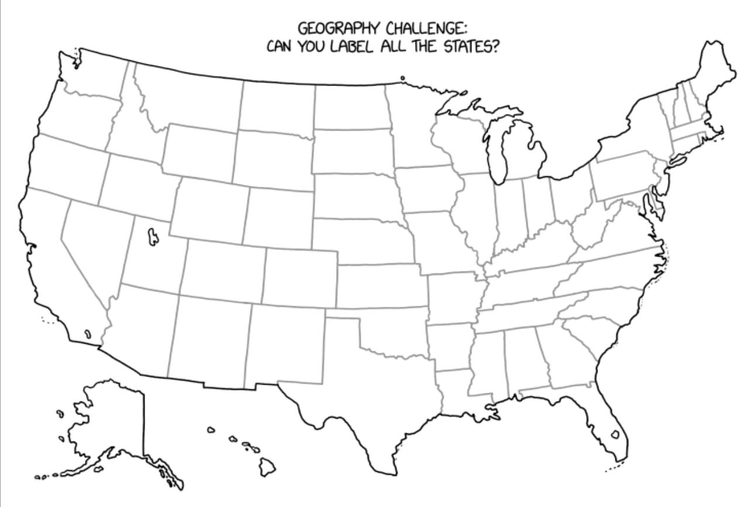
Welcome to PHYS 161
https://imgs.xkcd.com/comics/label_the_states.png

Slide 2
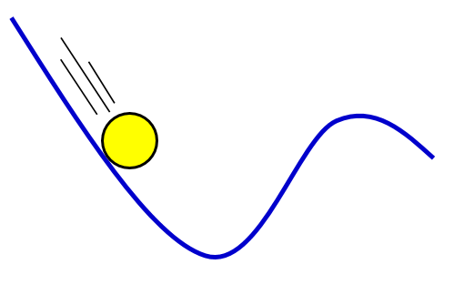
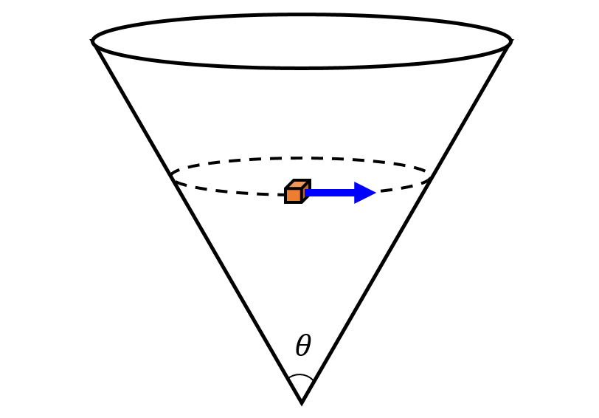
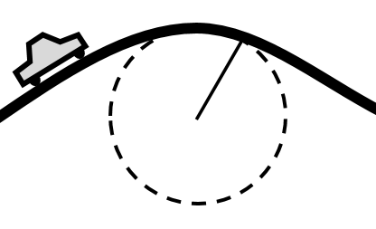
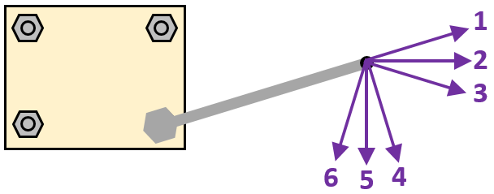
How useful is this class to your major?
Pre-Med
Engineering
Biology
Utility of concepts
Math
Architecture
Chemistry
Construction Management
Computer Science
Utility of computations

Slide 3
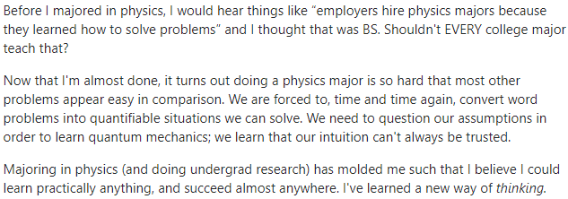
Interesting Quote
For all majors, it’s all about the problem solving.

Slide 4
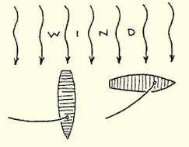
Top View of Two Sailboats: Which has higher top speed?
Explain Why…

Slide 5
Explain Why…

Slide 6
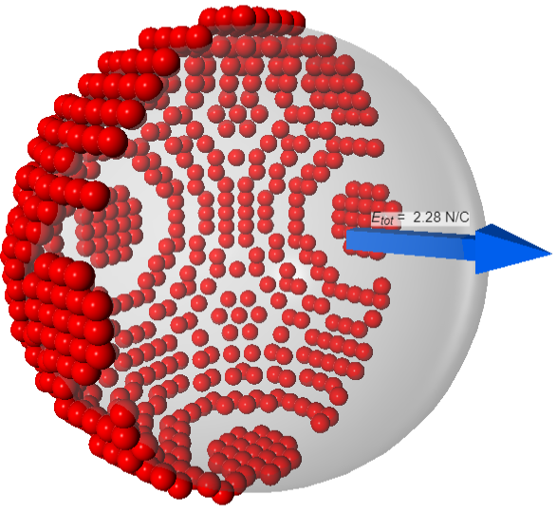
My goals in creating assignments
Involve practical job skills (lab)
Promote a detail-oriented mindset
Read carefully
Write & speak (lab) clearly
Create unambiguous visuals (lab)
Improve time management skills
See the beauty of physics & math

Slide 7
How much time should you be using your workbook in PHYS 161?
Based on survey responses from 24 students at the end of PHYS 161, Fall 2023

Slide 8
Take the plunge
Get both Workbooks ASAP
Get a scientific calculator
Free from MESA center?
Get a study group (up to 4)
Use the MESA center
Study early & often
More than just practice tests
Difficult to cram for this class
10 hrs a week outside of class

