Slide 1


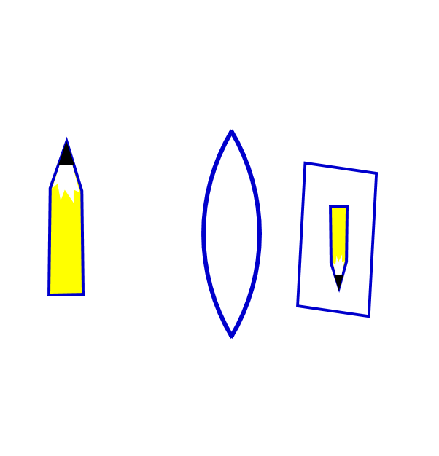

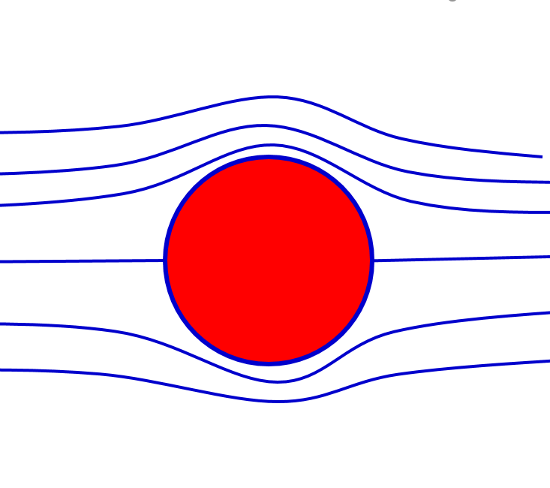

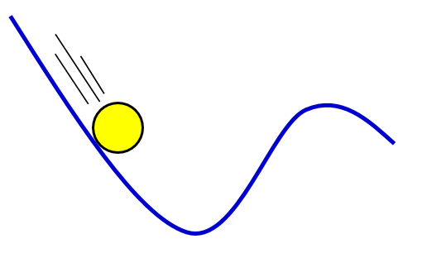

Physics & Astronomy at AHC
Rob Jorstad
STEM Week of Discovery
August 14, 2026

Slide 2

What worked for
my generation
What students
feel now
Go to college
Get a degree
Get a starter job
Land career that interests me
Buy a house
Save for retirement
College is expensive
My degree is worthless
I can’t get an interview
Employers can fire me at will
I’ll never buy a house
Retirement! I can barely pay bills…
AI is taking jobs & changing careers

Slide 3
Are the trades an option?
Job Title | National Avg Salary | Growth thru 2032
Ultrasonographer | $132k | 10%
Respiratory therapist | $104k | 13%
Dental hygienist | $99k | 7%
Construction manager | $88k | 5%
Aircraft mechanic | $82k | 4%
Cable technician | $71k | 6%
Industrial mechanic | $70k | 6%
Solar installer | $69k | 22%
Real estate appraiser | $64k | 5%
Electrician | $63k | 6%
Licensed practical nurse | $59k | 5%
Wind turbine technician | $58k | 45%
Pros
Some job growth
Good pay
Less school
Less debt
Hands-on
Satisfying work
Cons
Physical demands
Jobsite conditions
Variable commutes
Perception/stigma
Boredom?
Lower max pay
https://www.indeed.com/career-advice/finding-a-job/highest-paying-trade-jobs
“According to the Bureau of Labor Statistics (BLS), the average annual salary for all occupations in the U.S. is $61,900, and the average growth rate from 2022 to 2032 for all occupations is 3%. Here are 12 of the highest-paying trade jobs on the market listed from highest to lowest, with projected job growths of at least 4%.”

Slide 4
If not the trades, why STEM at AHC?
AHC gives you 2 quality years of education for cheap
Many STEM majors can still get good jobs
  Get 2 internships along the way
  Consider a graduate degree as well (many in STEM are paid)
  Computer science & software engineering – do your own research
  Other engineering majors still have good prospects
Where else can you get an edge?

Slide 5



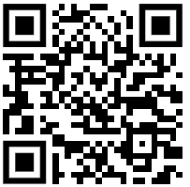
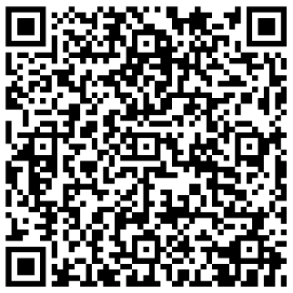

What college faculty are seeing…
Students can’t or won’t read
Students have trouble thinking critically
Students can’t do basic math
Everyone is Cheating Their Way Through College
https://archive.md/qIXd0
UC San Diego is trying to solve a remedial math problem
https://www.kpbs.org/news/education/2025/12/02/uc-san-diego-is-trying-to-solve-a-remedial-math-problem

Slide 6
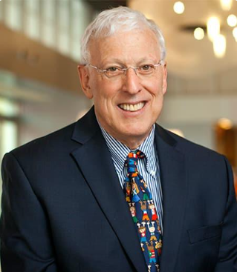
What college faculty are seeing…
“The greatest worry in these
times of generative AI is not that it may compromise human creativity or intelligence,
but that it already has.”
Dr. Sternberg was listed in the top 2% of scholars in citations in the field of education by Stanford University, November 2020 and is ranked #3 in citations in the field of education.
https://www.theguardian.com/technology/2025/apr/19/dont-ask-what-ai-can-do-for-us-ask-what-it-is-doing-to-us-are-chatgpt-and-co-harming-human-intelligence

Slide 7

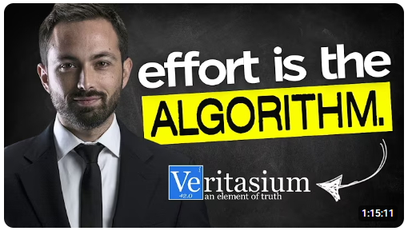
Is AI making the work easy for me or motivating me to do the hard things?
Am I using AI to dig in and engage with material or just get work done?
Am I blindly trusting AI output or checking sources?
The painful, effortful process
is the core process of learning,
even when it is hard
even when it is painful
even when you’re not great at it.
Vox: AI can do your homework. Now what? https://www.youtube.com/watch?v=bEJ0_TVXh-I
Veritasium: What everyone gets wrong about AI and learning https://www.youtube.com/watch?v=0xS68sl2D70

Slide 8

What to get out of a traditional college education?
How to self-regulate emotions in a group
How to interact and understand people who have different experiences & backgrounds
How to ask for help when you need it
Find your SPARK (so the grind becomes bearable)
Degrees from Swarthmore College & Columbia University
Director of Center for Universal Education
Professor at Georgetown University
Author of multiple books on education systems
Parent with children going through the same hell as you
The A.I. Education Shock https://www.youtube.com/watch?v=HQQtaWgIQmE

Slide 9

Skills Required for an AI world*
Adaptability & flexibility
Emotional intelligence
Proficiency in computer languages
Machine learning & deep learning expertise
Stats, probability, linear algebra, & calculus
Creativity
Logical thinking & deductive reasoning
Communication & collaboration
Lifelong learning mindset
*Disclaimer: no one really knows what jobs will look like in 10 years…but these also come up repeatedly in interviews with CEOs of AI companies & leading AI researchers
John Hopkins School of Engineering - https://ep.jhu.edu/news/11-essential-skills-for-a-job-in-artificial-intelligence/

Slide 10
Skills Required for an AI world
Physics classes help
with these
Adaptability & flexibility
Emotional intelligence
Proficiency in computer languages
Machine learning & deep learning expertise
Stats, probability, linear algebra, & calculus
Creativity
Logical thinking & deductive reasoning
Communication & collaboration
Lifelong learning mindset
*Disclaimer: no one really knows what jobs will look like in 10 years…but these also come up repeatedly in interviews with CEOs of AI companies & leading AI researchers
John Hopkins School of Engineering - https://ep.jhu.edu/news/11-essential-skills-for-a-job-in-artificial-intelligence/

Slide 11
Rest of my talk discusses
1) physics a possible major
2) tips on passing college physics
Do we want to talk about that?

Slide 12

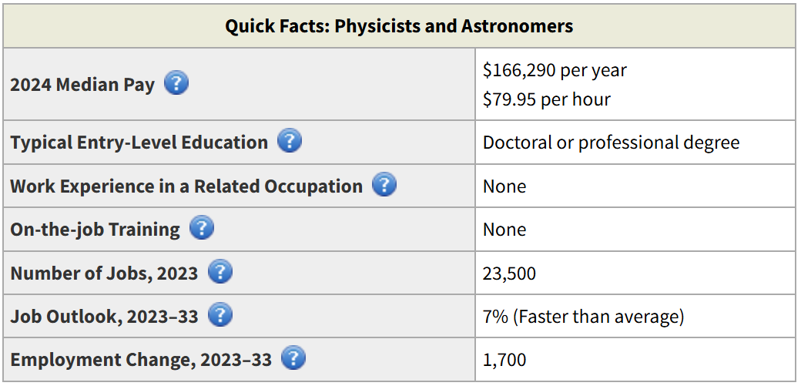
GOOD
Yikes!
GOOD
https://www.bls.gov/ooh/life-physical-and-social-science/physicists-and-astronomers.htm

Slide 13

Physics
If you want jobs in academia or research
  Courses in calculus, linear algebra, stats
  Computer science typically useful
  Get a Bachelor’s degree (4 years)
  Get a Ph.D. (6 years, paid $25k + all school expenses)
  Often require 1 or more post-docs (2-6 years, paid $65k)
  That’s 12-16 years before getting paid $150k…
What can you do with a Bachelor’s degree?
  Technician or assistant in related fields
    Engineering
    Computer science
    Data Science
  K-12 Teaching
  Some government jobs
  Average starting at $60k but ranges wildly
  Out perform pre-meds on MCAT (source: APS, 2015)
  Out perform pre-law on LSAT (source: APS, 2015)
https://www.bls.gov/ooh/life-physical-and-social-science/physicists-and-astronomers.htm#tab-4
https://www.aps.org/careers/guidance/webinars/upload/Careers-Talk.pdf, salary info from multiple source including Zip Recruiter, UC Merced, APS, etc

Slide 14

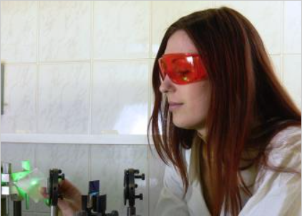
Physics
“Important Qualities” to be Successful in Physics & Astronomy
Analytical skills
  Evaluate work (your own & other’s) to avoid errors
Communication skills
  Present to the public and write technical reports
Critical-thinking skills
  Determine if results & conclusions are accurate using logic
Interpersonal skills
  Collaborate and work well with team members & colleagues
Math skills
  Use calculus, algebra, geometry, & “other areas of math”
Problem-solving skills
  Observe & analyze carefully. “For example, they may need to redesign their approach and find alternatives when an experiment of theory fails to produce the desired result.”
Self-discipline
  Stay motivated & “focus on large data sets for long periods”
https://www.bls.gov/ooh/life-physical-and-social-science/physicists-and-astronomers.htm#tab-4

Slide 15
Quotes from
Carnegie Mellon Students
https://www.cmu.edu/student-success/other-resources/fast-facts/succeed-in-physics.pdf

Slide 16
Quotes from
Carnegie Mellon Students
Physics is an infamously difficult course. I consistently needed help with the material. It is not impossible though.
Brian Electrical & Computer Engineering
https://www.cmu.edu/student-success/other-resources/fast-facts/succeed-in-physics.pdf

Slide 17
Quotes from
Carnegie Mellon Students
Physics is an infamously difficult course. I consistently needed help with the material. It is not impossible though. | Physics is incredibly intimidating and difficult. I used office hours and tutoring and built a strong bridge and was successful in the class.
Brian Electrical & Computer Engineering | Mridula Chemistry
https://www.cmu.edu/student-success/other-resources/fast-facts/succeed-in-physics.pdf

Slide 18
Quotes from
Carnegie Mellon Students
Physics is an infamously difficult course. I consistently needed help with the material. It is not impossible though. | Physics is incredibly intimidating and difficult. I used office hours and tutoring and built a strong bridge and was successful in the class. | Weekly study groups were most effective of all the support offered because it forced me to form a study routine and it allowed me to work closely with other students in small groups.
Brian Electrical & Computer Engineering | Mridula Chemistry | Rohan Math
https://www.cmu.edu/student-success/other-resources/fast-facts/succeed-in-physics.pdf

Slide 19
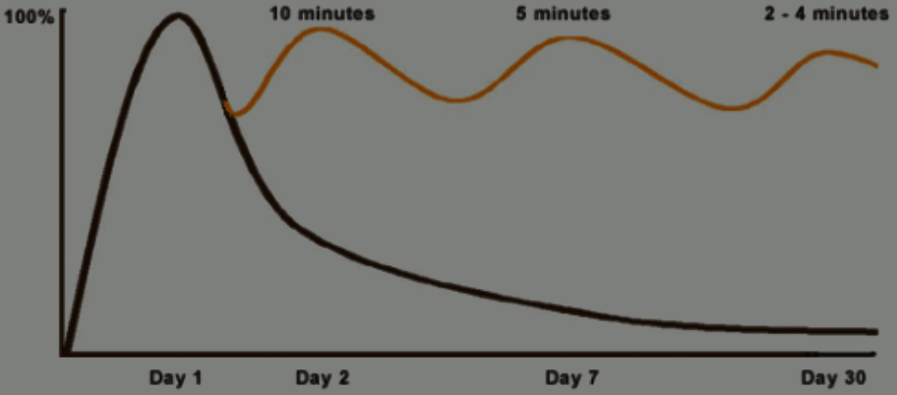
The Curve of Forgetting
Why have a study group?
You forget if you don’t practice.
It is more fun & efficient to practice with a group
When you explain concepts to others, you understand them better.
When you articulate questions, you improve communication skills.
19
From U Waterloo https://uwaterloo.ca/campus-wellness/curve-forgetting

Slide 20
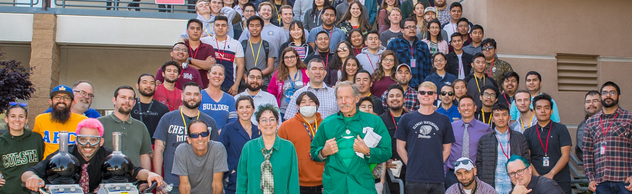
Get a good study group (no flakes)
Start homework early
Go to office hours
Avoid over-reliance on AI & solutions
Read book & watch lectures
Time management: Plan your study schedule for all classes
Struggling with material pays off by senior year
Reward system as you learn to study
The End?

